Slide 1
Welcome to Child Sponsorship Sunday!
ncm.org/sponsorship

Slide 2
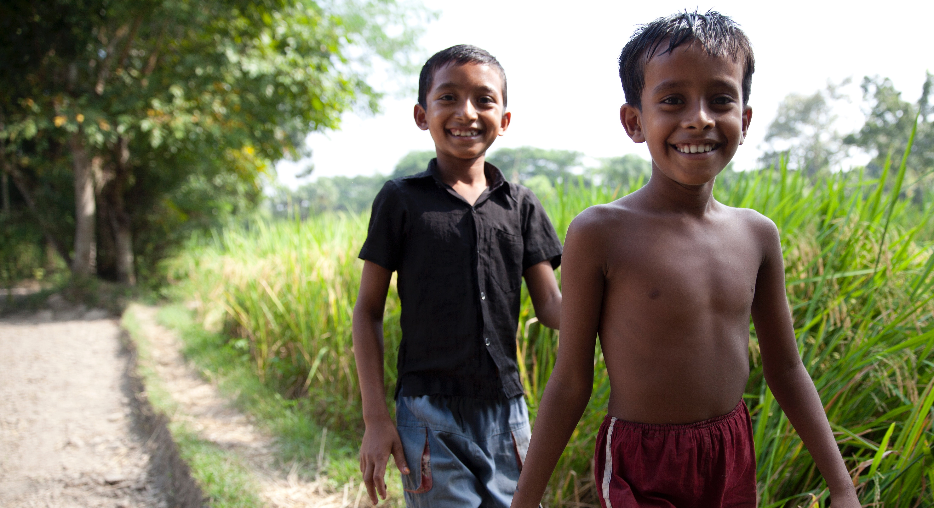
Jesus said, “Let the
little children come to me, and do not hinder them, for the kingdom of heaven belongs to
such as these.”
Matthew 19:14

Slide 3
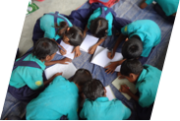
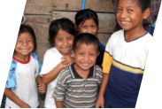
The reality: Poverty leaves children vulnerable.
• 1.8 billion children under 15 live in our world — all created in God’s image. But about half of them are living in poverty, and 1 in 3 lives on less than $1 a day.
• Count to 60. In that time, 21 children under age 5 have died mainly due to poverty-related diseases and malnutrition. That’s over 30,000 children who die every day mostly from preventable causes.

Slide 4
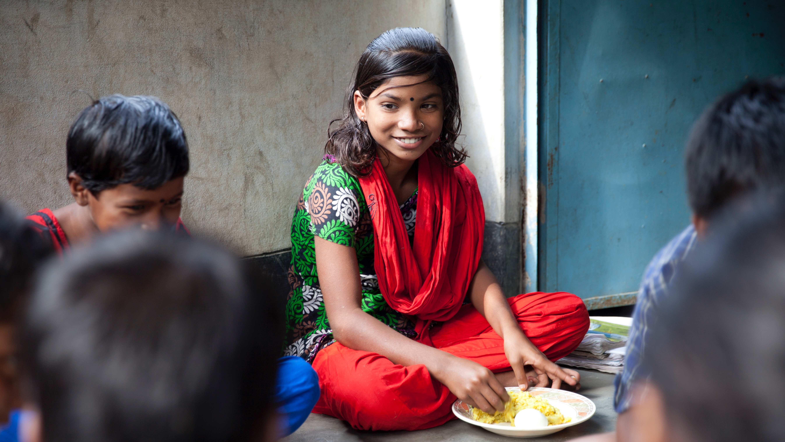
The reality: Poverty robs children of their potential.
• Globally, nearly 1 in 5 children has never had a chance to attend school.

Slide 5
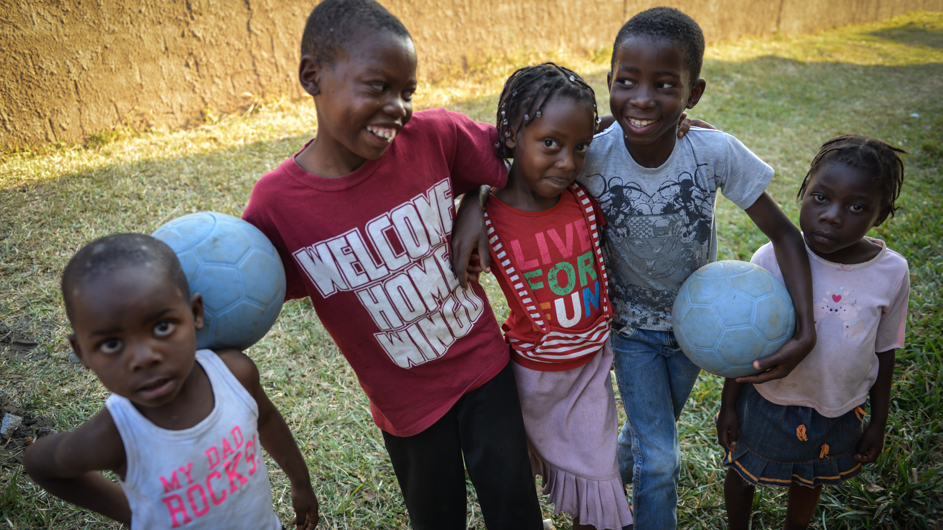
The reality: Poverty forces children to grow up too fast and steals their childhood.
• 1 of every 6 children ages 5 to 17 works as a child laborer; 73 million are under the age of 10.

Slide 6
Every one of these children is loved by God.
He took a little child whom he
placed among them. Taking
the child in his arms, he said
to them, “Whoever welcomes
one of these little children in
my name welcomes me; and
whoever welcomes me does
not welcome me but the one
who sent me.” - Mark 9:36-37

Slide 7
You can change a child’s story from one of poverty to one of possibility.
You can give hope for a better future.

Slide 8
You can sponsor a child in need for just $30 a month.
Under
$1
a day
Your sponsorship will provide a child with:
- Bible-based lessons
- Knowledge of Jesus’ love
- A chance at a hope-filled future
- Education
- Nutrition
- Life and Social Skills

Slide 9
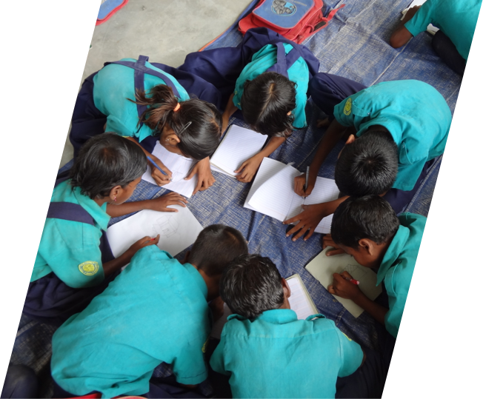
Child sponsorship creates a personal relationship between a sponsor and a child.
Your relationship with your sponsored child will provide hope and encouragement.
Your letters will remind your sponsored child that he or she matters and is loved!

Slide 10
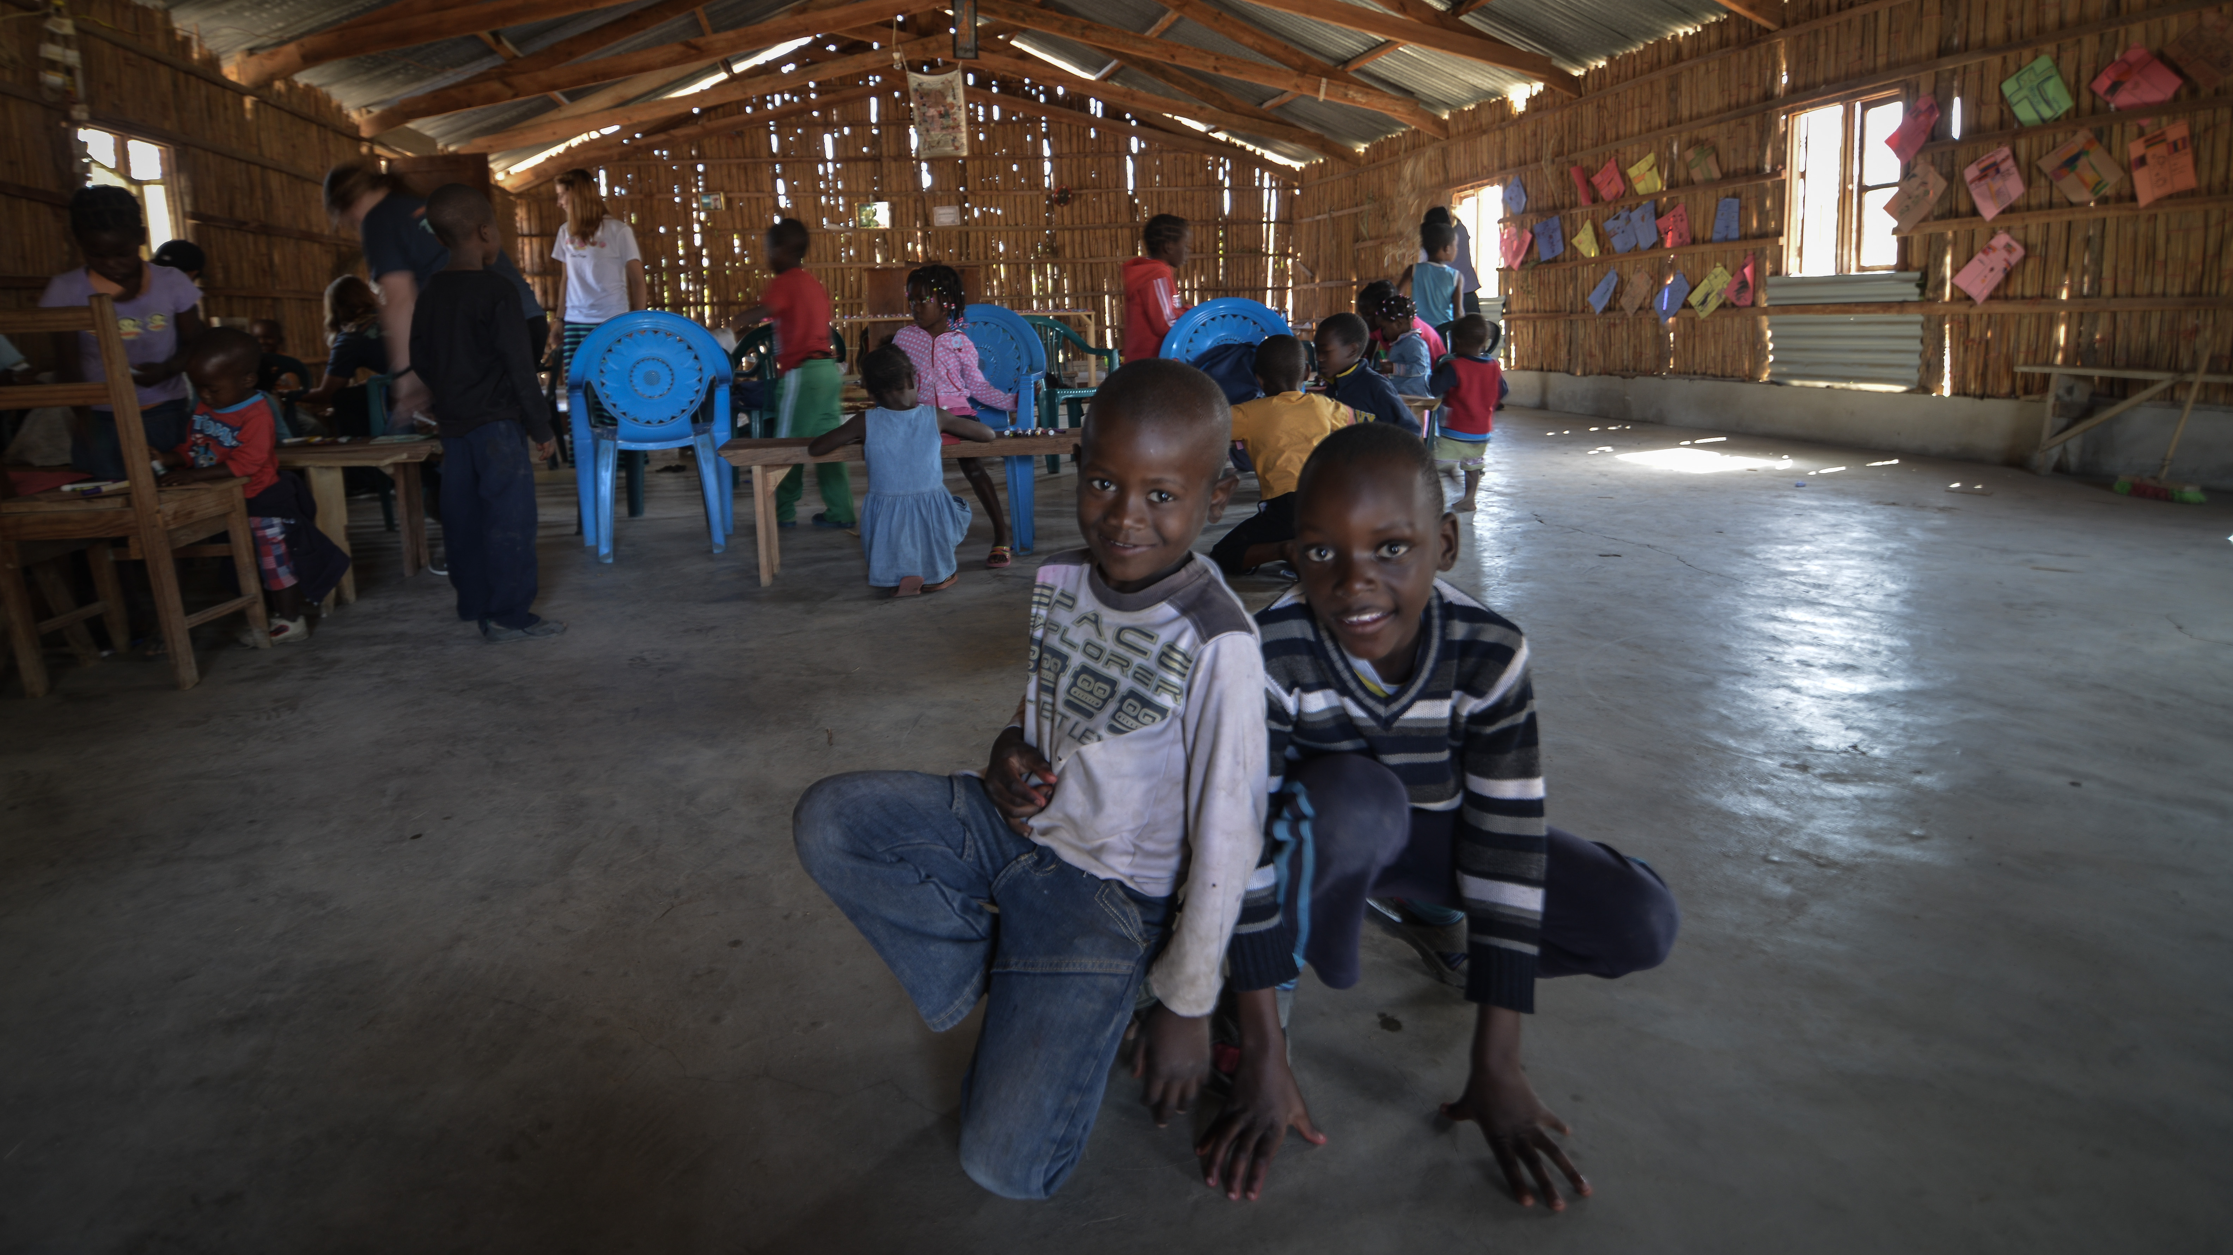
Connected to the local church.
Spiritual Development
NCM’s Child Sponsorship program takes place in partnership with local churches that seek to help children understand that God loves them, they are valued and have God-given dignity, and they can have a personal relationship with Jesus.

Slide 11
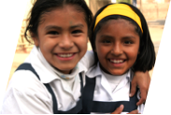
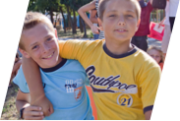
Will you make a difference?
Visit the sponsorship table after the service to learn how you can change a child’s life through sponsorship.

Slide 12
ncm.org/sponsorship

